Slide 1
Key Stage 4 Music LTP and Assessment Info
Slide 2 – KS3 LTP (sequence of learning)
Slide 3 – KS3 assessment information
Slide 4 – KS3/Mosaic Knowledge and Skills Grid for music
Slide 5 – KS4 Entry 2/Entry 3 LTP (sequence of learning) WJEC Creative Pathways
Slide 6 – KS4 Entry 2/Entry 3 assessment information WJEC Creative Pathways
Slide 7 – KS4 Entry 1 LTP (sequence of learning) ASDAN Life Skills Challenge
Slide 8 – KS4 Entry 1 assessment information ASDAN Life Skills Challenge
Slide 9 – KS3 & KS4 Mosaic LTP (sequence of learning)
Slide 10- KS4 Mosaic assessment information
Slide 11 - KS3 & KS4 Mosaic Knowledge And Skills Grid
Slide 12 – (FYI) Sounds of Intent Framework music development statements – bridging the gap between Kaleidoscope and Nexus music

Slide 2


Expressive Arts SEQUENCE OF LEARNING KS3
Year 1, 2, 3 Music 2024-2027
NEW
Year 1 24-25 | Year 2 25-26 | Year 3 26-27 | Mosaic
Content 6 – 8 weeks on carousel
Exploring Instrument Families - Ukuleles - Charanga ‘Wind Instrument’ Stage 1 - Untuned percussion | Developing keyboard skills Charanga Keyboard- Stage 1 Chords Exploring keyboard facilities | Exploring World Music Charanga World Music- Glockenspiel – Stage 1 Indonesian Gamelan Samba – music from Brazil | Developing reactive (listening) and proactive & interactive (practical music-making) skills. Where appropriate, there will be crossover into the Nexus LTP.
Knowledge and Skills Students work across the K&S criteria at own pace throughout the 3 years.
play and perform in solo and ensemble contexts, using their voices and playing musical instruments with increasing accuracy, fluency, control and expression improvise and compose music for a range of purposes using the inter-related dimensions of music listen with attention to detail and recall sounds with increasing aural memory use and understand staff and other musical notations appreciate and understand a wide range of high-quality live and recorded music drawn from different traditions and from great composers and musicians develop an understanding of the history of music

Slide 3
KS3 Music Assessment
Details of summative assessments currently used - assessment criteria are from the 2013 primary music national curriculum
Frequency of assessments – formative assessments during lessons, as and when students have completed a task.
Format of assessments – practical.
How results are currently recorded (spreadsheet, online system, highlighted ‘I can’ statements, etc.). Highlighted ‘I can’ statements on individual Knowledge And Skills Grids. Written teacher/TA observations. Audio/video recordings.
Where evidence of levels can be found – staff records, audio/video recordings, class work folders.
Moderation – discussed with TAs in lessons.

Slide 4
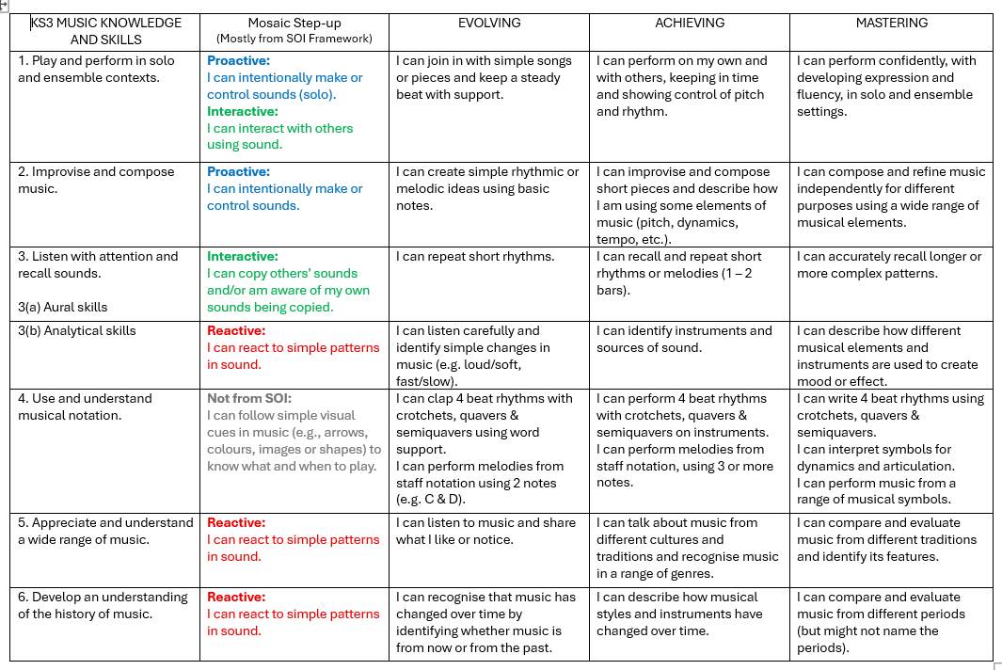

Slide 5
Expressive Arts SEQUENCE OF LEARNING KS4 Nexus E2 & E3
Year 1, 2 Music 2024-2026
NEW
Year 1 24-25 | Year 2 25-26
Content
Develop basic improvisation skills using clear frameworks. Create and organise musical ideas to form compositions, e.g. blues, cyclical, pentatonic, and appraise own compositions. Respond to musical pieces with musical vocabulary to describe how the building blocks of music are used to create effects (tempo, dynamics, texture, melody, harmony, pitch, duration, rhythm), including how contrast is used. Listen to music from different genres to learn their stylistic features. | Practise basic performance skills on a range of instruments then choose one in which to specialise for solo coursework. Learn and perform ensemble music in a range of genres. Complete practice logs for solo and ensemble work which are reflective, identifying strengths and weaknesses of performances, and next steps.
Knowledge and Skills
Entry Level 2 and 3 (E2 80 GLHrs, E3 100 GLHrs) Composing Music 6342 Appraising Music 6343 Learn the skills required to compose a variety of pieces in different musical styles: create imaginative ideas making use of musical elements organise musical ideas use resources (instruments/software) in keeping with chosen genres store the final compositions (either in writing or recording) identify the strengths and weaknesses of the compositions with reference to the musical elements and selected genres identify how to address weaknesses and show an attempt to improve the compositions appraise others’ compositions listen to and appraise music from a range of genres and traditions identify changes in tempo, timbre, rhythm, dynamics and texture identify distinctive melodic and musical features in contrasting genres of music. | Entry Level 2 and 3 (E2 80 GLHrs, E3 100 GLHrs) Solo Music Performance 6340 Ensemble Music Performance 6341 Learn the skills required to perform a variety of solo/ensemble pieces: sing or play short, simple solo/ensemble pieces show technical control of the chosen instrument/voice in a fluent and mainly accurate performance perform with appropriate expression identify the strengths and weaknesses of the performances identify how to address weaknesses and show an attempt to improve the performances appraise others’ performances listen to and appraise music from a range of genres and traditions.

Slide 6
Assessment KS4 Music – WJEC E2/E3 units
Summative assessment criteria and how these are assessed – assessed against Entry Level 2 or 3 WJEC Creative Pathways units criteria.
Frequency of assessments – as and when students have learnt a piece of music or completed a task. Combination of formative and summative.
Format of assessments - Collation of practical tasks, written progress logs, staff witness statements, transcripts of evaluative dialogue between staff and students. Assessment record then completed.
How results are currently recorded – audio/video recordings of performances/compositions. WJEC assessment records.
Where evidence of levels can be found – students’ coursework folders and network.
Moderation – discussions with TAs during lessons. External moderation.

Slide 7
Expressive Arts SEQUENCE OF LEARNING KS4 Nexus E1
Year 1, 2 Music 2024-2026
NEW
Year 1 24-25 | Year 2 25-26
Content
Listening and Appraising: be able to enjoy and respond to a range of music. Composing: make a variety of choices and communicate a variety of preferences and feelings during music sessions. | Performing: be able to play and identify musical instruments taking into account tempo and volume, and follow an adapted musical motif.
Knowledge and Skills
Entry Level 1 ASDAN LSC unit 9129 Engaging With Music (10 hours) listen to five pieces of music from a range of genres identify one musical element for three songs rank songs by preference respond to the tempo and volume of music through movement explore song lyrics. Entry Level 1 ASDAN LSC unit 6249 Communicating and Making Choices In Music (10 hours) show a preference when choosing a musical instrument use a musical instrument to communicate a word or emotion listen to a variety of music or sounds and show a preference. | Entry Level 1 ASDAN LSC unit 4757 Playing An Instrument And Following A Motif (10 hours) be able to recognise a musical instrument participate in a musical activity using an instrument participate in an activity where they need to follow a musical motif.

Slide 8
Assessment KS4 Music – ASDAN LSC E1/WTE units
Summative assessment criteria and how these are assessed – combination of formative and summative. Assessed against ASDAN Life Skills units criteria.
Frequency of assessments – as and when students have completed a task.
Format of assessments - practical tasks, questioning and transcripts, observations.
How results are currently recorded – audio/video recordings of performances/compositions/dialogue. Records of questioning. Observation checklists.
Where evidence of levels can be found – students’ coursework folders and network.
Moderation – discussions with TAs during lessons. Completion of ASDAN internal moderation checklists.

Slide 9
Expressive Arts SEQUENCE OF LEARNING KS3 & KS4 Mosaic
Year 1, 2 Music 2024-2026
NEW
Repeated annual cycle of content, ensuring reinforcement, familiarity and building confidence. Individual learning needs are met through adaptive teaching and differentiation within lessons.
Exploration of tuned and untuned instruments. Simple improvisation using limited note sets or sound options. Using the voice for sounds, chants, and simple songs. Playing body percussion to backing tracks or pulse patterns. Perform in an ensemble, following conductor gestures, on-screen cues or verbal cues. Exploring simple music apps, digital instruments and sound effects. Respond to music with contrasting elements, e.g. loud/quiet, fast/slow, high/low. Make movements and actions in response to music. Use visual/physical/verbal methods of expressing opinions about music.
Knowledge and Skills
Develop a range of composing, performing, listening and appraising skills: make, control and create sounds in solo and ensemble contexts listen and respond to a wide range of musi interact with music technology follow simple visual cues in music to know what and when to play.

Slide 10
Assessment: KS3 & KS4 Music Mosaic
Formative assessments using Sounds of Intent Framework which evaluates students’ awareness of sound, their engagement in music activities and their ability to initiate musical activities.
Some Mosaic students may move onto the EVOLVING stage of the Knowledge And Skills Grid, for some content.
Frequency of assessments - ongoing formative assessments during lessons.
Format of assessments – practical.
How results are currently recorded – audio/video recordings, teacher/TA observations and notes, highlighted ‘I can’ statements on individual Knowledge And Skills Grids.
Where evidence of levels can be found – audio/video recordings, evidence written by staff in lessons. Individual Knowledge And Skills Grid for each student – in class work folders.
Whether any moderation of levels has taken place, and if so, was this internal or external? Discussion with TAs during lessons.

Slide 11
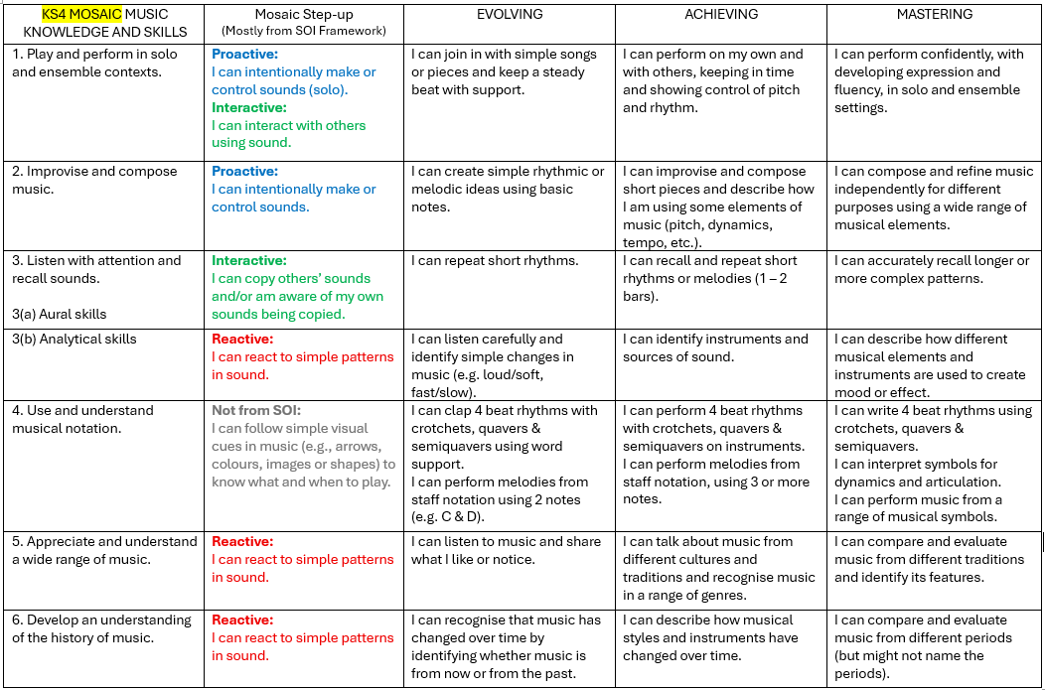

Slide 12
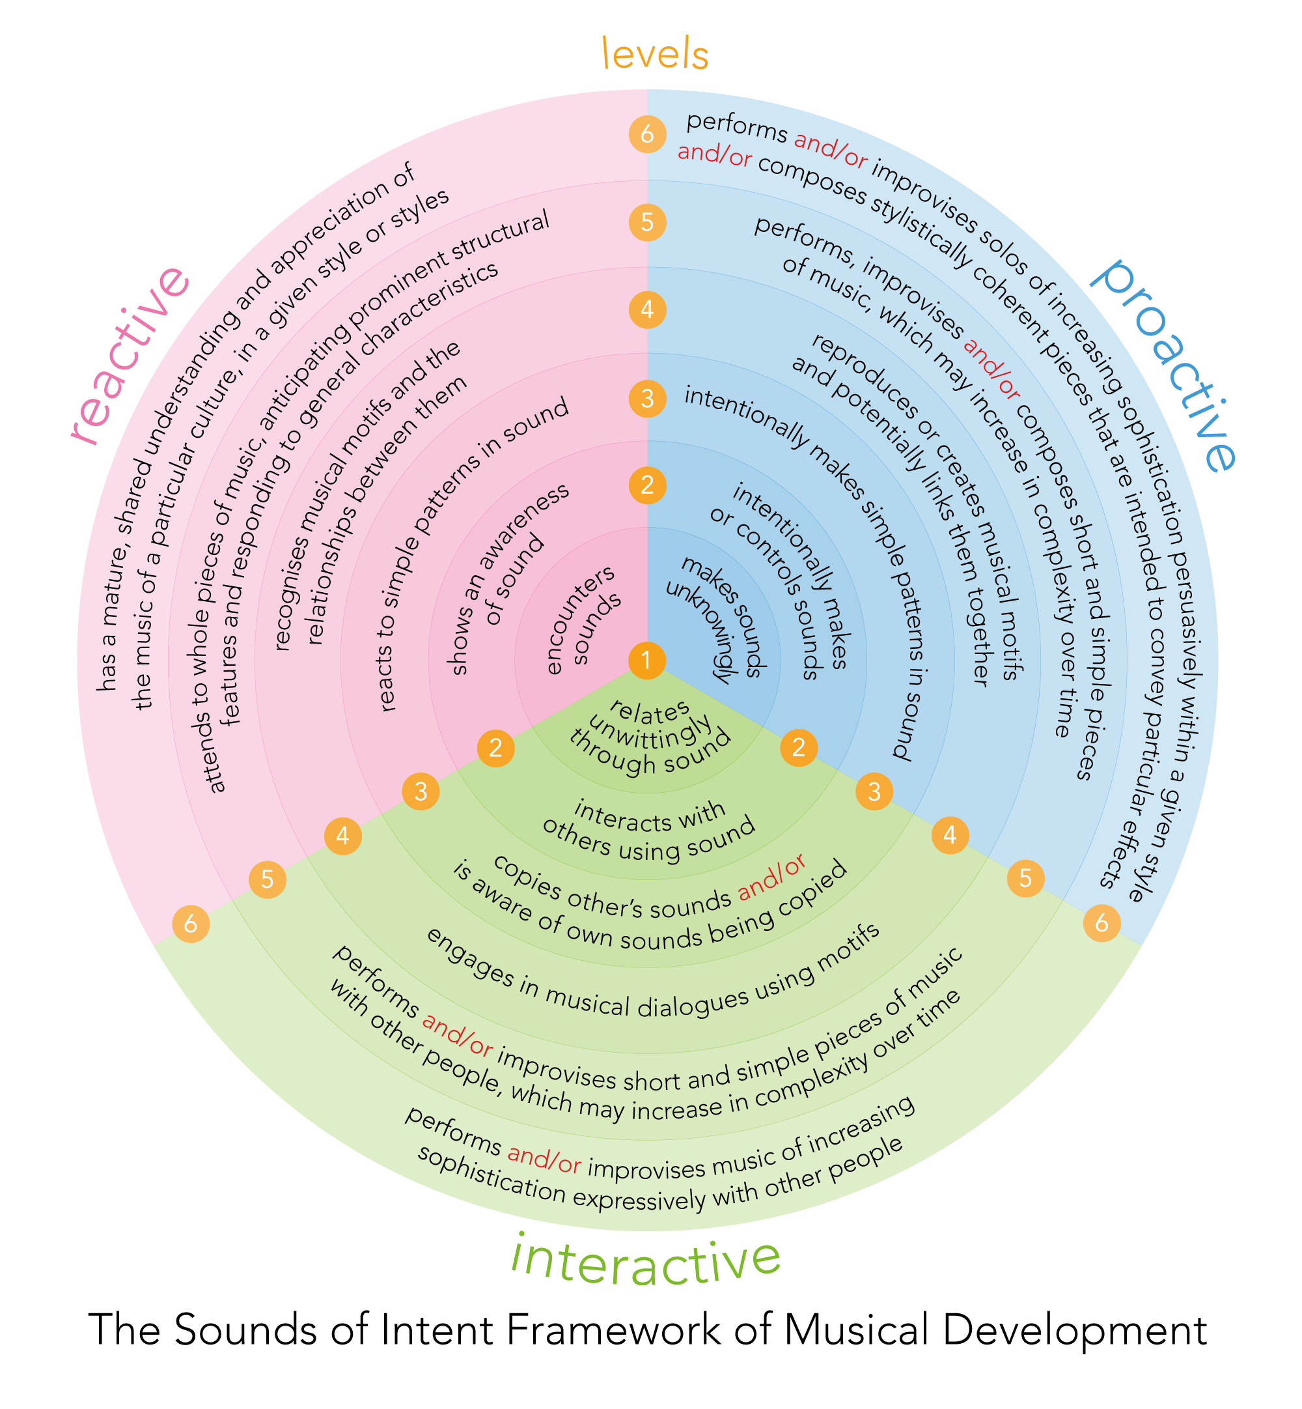
Sounds Of Intent Framework
(some statements used for
Mosaic Step-up outcomes)

